Slide 1
Chapter 7: Structural and Behavioral
Design Patterns
Session I: Adapter, Composite, Facade

Slide 2
Session’s Agenda
Structural Patterns in Detailed Design
Adapter
  Character adapter example
Composite
  Message generator example
Facade
  Subsystem interface example
What’s next…

Slide 3
Structural Design Patterns
Structural design patterns are patterns that deal with designing larger structures from existing classes or objects at run time.
  They play a key role in the design and evolution of systems by allowing integration of new designs with existing ones, via object composition (i.e., object structural) or inheritance (i.e., class structural).
Popular structural design patterns include:
  Adapter
  Composite
  Facade

Slide 4
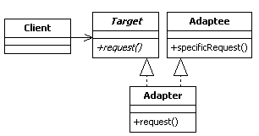
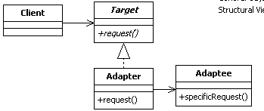
Adapter Design Pattern
The Adapter design pattern is a class/object structural design pattern used to adapt an existing interface that is expected in a software system.
According to the GoF, the intent of the Adapter is to [1],
  Convert the interface of a class into another interface clients expect. Adapter lets classes work together that couldn’t otherwise because of incompatible interfaces.
Class Structural version of Adapter Pattern
Object Structural version of Adapter Pattern

Slide 5
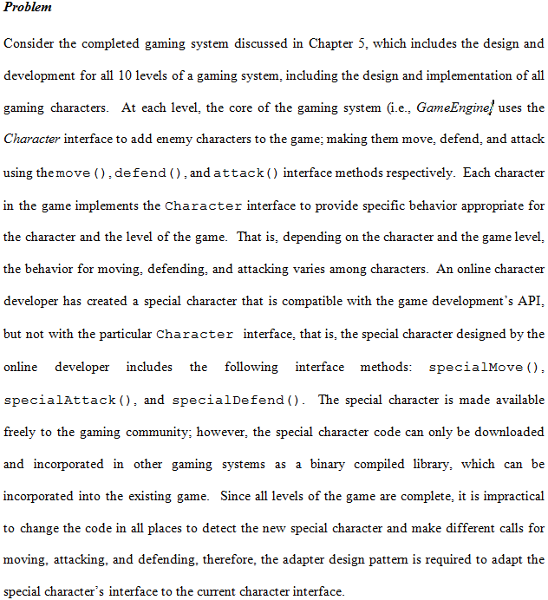
Adapter Design Pattern Example

Slide 6
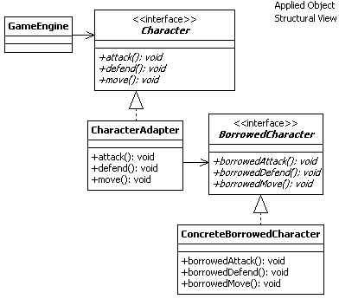
Adapter Design Pattern Example
Here’s the object Structural version of Adapter Pattern
The idea is to implement the Character interface methods in terms of the BorrowedCharacter methods!
Here’s the object Structural version of Adapter Pattern applied to the gaming problem
Let’s see how this is done…

Slide 7
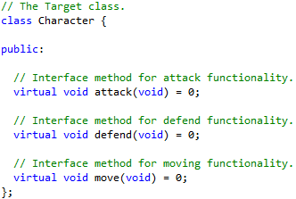
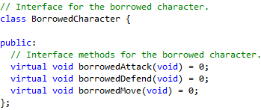
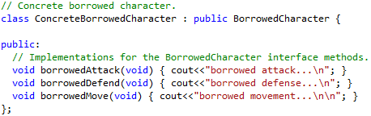
Adapter Design Pattern Example
Notice the incompatible interfaces!
Under this current conditions, you cannot use a ConcreteBorrowedCharacter in the gaming system without changing the code!

Slide 8
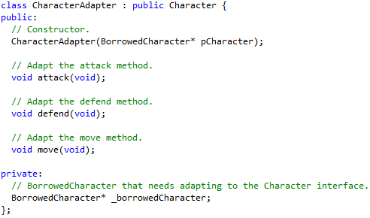
Adapter Design Pattern Example
Character is the Target class
The CharacterAdapter
We configure the Adapter with its Adaptee
The class that we are adapting

Slide 9
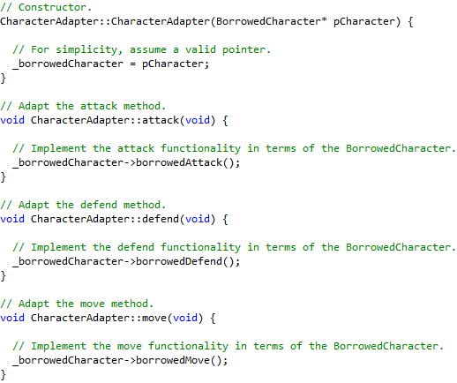
Adapter Design Pattern Example
Step 1. Configure the Adapter with its Adaptee
Step 2. Override each Character method to implement the behavior in terms of the Adaptee, in this case, the BorrowedChracter
With this design in place, you can now use CharacterAdapter to provide BorrowedCharacter services throughout the game!

Slide 10
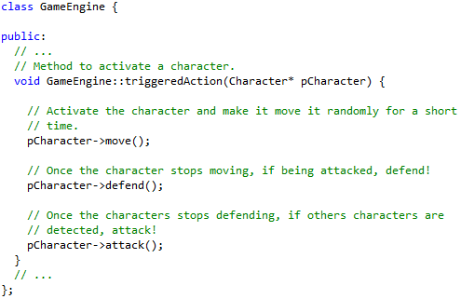
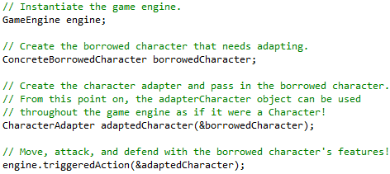
Adapter Design Pattern Example
The GameEngine expects all characters to obey the Character interface
This is how you would adapt the borrowed character and use it in the GameEngine
Assuming the gaming engine has code similar to this

Slide 11
Adapter Design Pattern
The step-by-step approach for designing the object structural adapter design pattern is presented as follows:
  Identify the source and destination interfaces that need adapting in the new system (e.g., Target and Adaptee or Character and SpecialCharacter).
  Add a new class (e.g., Adapter or AdaptedCharacter) in the design that realizes the Target interface and implements it in terms of the Adaptee’s implementation. This requires a realization relationship between the Adapter and Target, and an association between the Adapter and the Adaptee.
  In the new system, whenever objects that share the Target interface are expected, it can now be possible to use the Adapter objects created in step 2.
Benefits of the Adapter design pattern include:
  Allows classes with incompatible interfaces to work together, therefore it increases reusability and ease of code integration.
  Provides a standard way for integrating a plurality of different types to existing software.

Slide 12
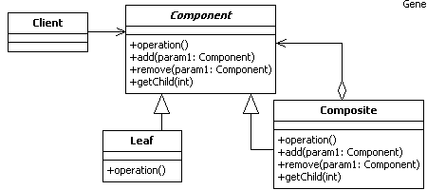
Composite Design Pattern
The Composite design pattern is an object structural pattern that allows designers to compose (large) tree-like designs structures by strategically structuring objects that share a whole-part relationship.
According to the GoF, the intent of the Composite is to [1]
  Compose objects into tree structures to represent whole-part hierarchies. Composite lets clients treat individual objects and composites of objects uniformly.

Slide 13
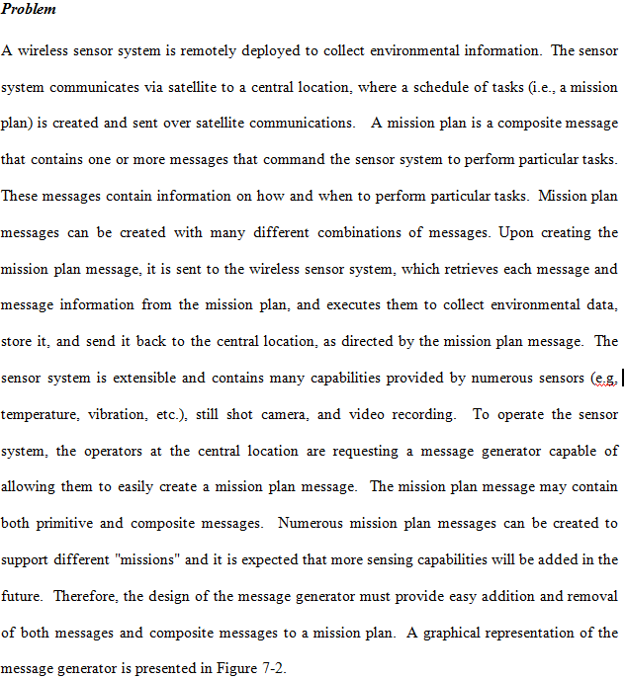
Composite Design Pattern Example
A graphical representation Is presented in the next slide…

Slide 14
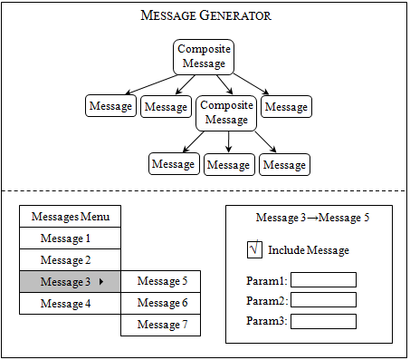
Composite Design Pattern Example
A Mission Plan Message dictates what happens in the system. It is a message composed of other messages.
This is one message. More specifically, it is a composite message composed of other messages
This is also a message, but, unlike the composite, this primitive message does not contain other messages!
We want to use a GUI to allow operators to create Mission Plan messages
In this example, Message 3 is a composite message. We can include, e.g., Message 5 as part of the Message 3 composite message.
We want to use a GUI to allow operators to create Mission Plan messages
Both primitive and composite messages ARE messages, so we want to treat them the same way to retrieve their IDs, print them, transform them to XML, etc., and transfer them through the system.

Slide 15
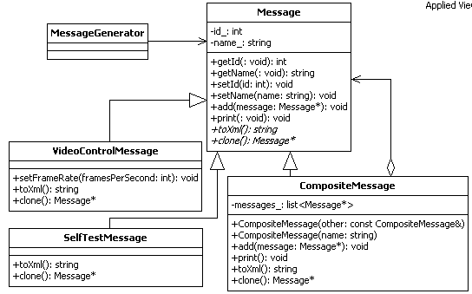
Composite Design Pattern Example
The client
The Component
Primitive message for video collection control
(Leaf )
Composite message. This one is used to create composite messages, e.g., the mission plan message
Example of primitive messages
Primitive message for executing a system test to ensure everything is working OK
(Leaf)

Slide 16
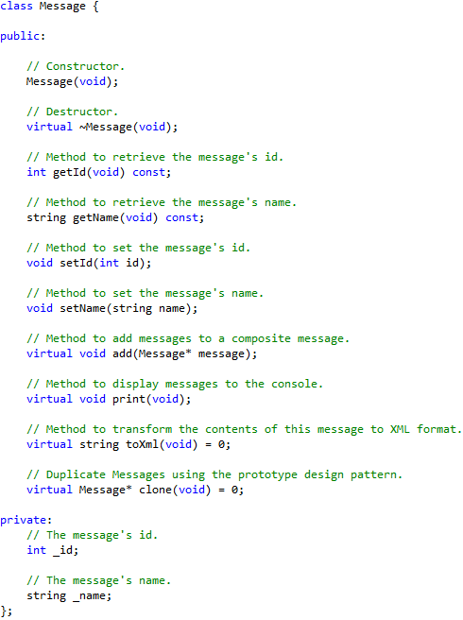
Composite Design Pattern Example
These apply to both primitive and composite messages
What do you think should happen when executing a print, toXml, or Clone on composite messages?
However, consider these four methods
Stop and think about this!
Remember the Prototype design pattern?

Slide 17
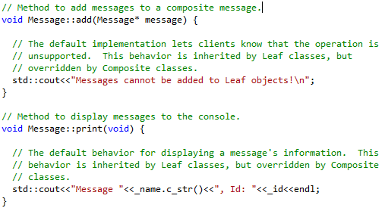
Composite Design Pattern Example
Let’s examine two methods, the add and print for primitive messages…
We could also have a default implementation that throws an exception!
For primitive messages, we don’t have to add any other messages, so we’ll have a default implementation for this
For primitive messages, printing a message entails printing its content, so we’ll have this as default implementation

Slide 18
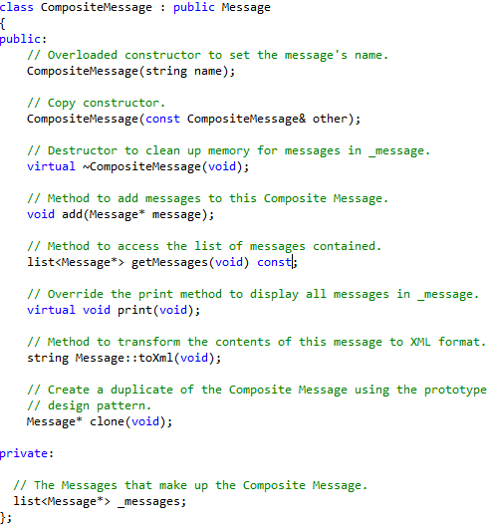
Composite Design Pattern Example
Nothing fancy here, simply realizing the Message interface
Composite contain other messages, so we’ll use a list to hold these other messages

Slide 19
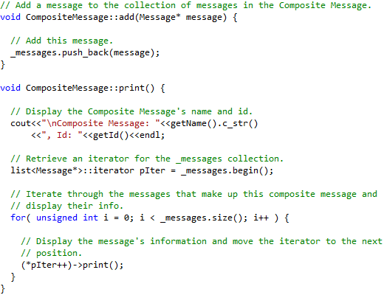
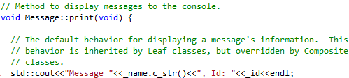
Composite Design Pattern Example
This code adds a message to the list of contained messages
When the print is called on the composite message, it must call print on all of its contained messages!
This code displays the composite message’s id and name, but also, it needs to iterate through the list of contained messages and calls print on each of them!
This same principle is employed on the toXml and clone methods!
Compare this with the print for primitive messages! Yikes!

Slide 20

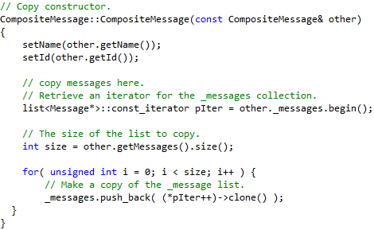
Composite Design Pattern Example
Override the copy constructor!
Iterate through the list of contained messages and calls clone on each of them to properly create a copy of the composite message!
A clone on the composite means cloning of all contained messages as well!
Isn’t it nice to have the Prototype design pattern? This way, we don’t need to know the actual specific object that we’re cloning!

Slide 21
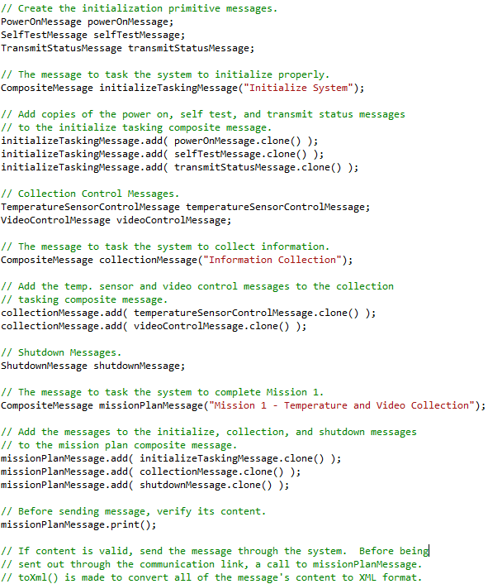
Composite Design Pattern Example
Create primitive messages
Add messages to the composite message to initialize the system
More primitive messages
Add messages to the composite message for scheduling data collection
Another composite message. This one is used for controlling the collection of information by the sensor system.
Schedule a shutdown system message
The mission plan message, which contains two composite messages and one primitive message
Print to the console the mission plan message

Slide 22
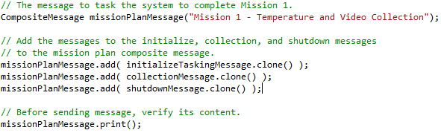
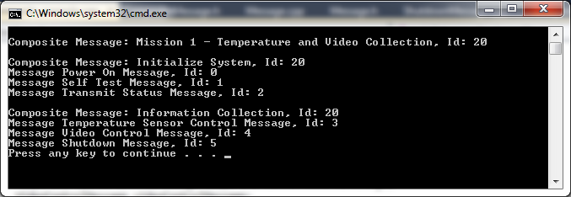
Composite Design Pattern Example
Sample output

Slide 23
Composite Design Pattern
The steps required to apply the composite design pattern include:
  Identify, understand, and plan the tree-like structure required for the system.
  With the knowledge from step 1, identify and design the Component base class (see diagram), which includes overridable methods common to both Leaf and Composite objects, as well as methods specific for Composite objects, which provide capability for adding and removing objects to the hierarchy.
  For the methods specified in step 2 for adding/removing objects to the hierarchy, implement default behavior that if not overridden, will result in exception or error message indicating an unsupported operation.
  Identify and design the Composite class, which overrides methods for adding and removing objects to the hierarchy. The Composite class requires an internal data structure to store Leaf nodes added to the hierarchy. In addition, the Composite class is required to override all other methods identified in step 2 to implement functionality in terms of the composite object and all of its contained Leaf objects.
  Identify and design the Leaf classes, which overrides methods specified in step 2 to implement behavior in terms of the Leaf object. Leaf objects do not override the add and remove methods identified in step 2.
  Identify and design the client that uses both composite and leaf objects.
Benefits of the Composite design pattern:
  Provides a design structure that supports both composite and primitive objects.
  Minimizes complexity on clients by shielding them from knowing the operational differences between primitive and composite objects. Clients that expect a primitive object will also work with a composite object, since operations are called uniformly on both primitive and composite objects.
  Easy to create and add new components objects to applications.

Slide 24
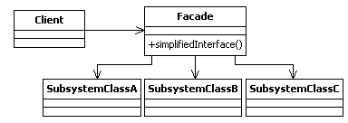
Facade Design Pattern
The Facade design pattern is an object structural pattern that provides a simplified interface to complex subsystems.
According to the GoF, the intent of the Facade is to [1]
  Provide a unified interface to a set of interfaces in a subsystem. Facade defines a higher-level interface that makes the subsystem easier to use.

Slide 25
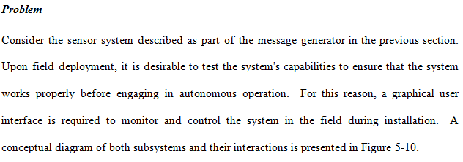
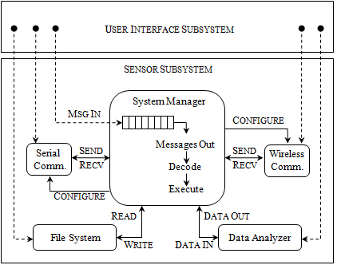
Facade Design Pattern Example

Slide 26
Facade Design Pattern Example
User Interface Subsystem
Client1
Client2
Client3
Client4
SerialComm
SystemManager
FileSystem
DataAnalyzer
WirelessComm
Sensor Subsystem

Slide 27
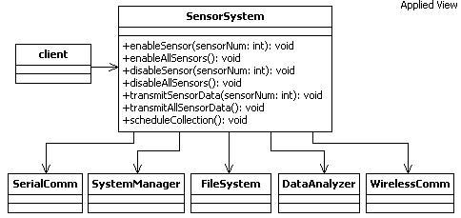
Facade Design Pattern Example
User Interface Subsystem
Client1
Client2
Client3
Client4
The Facade

Slide 28
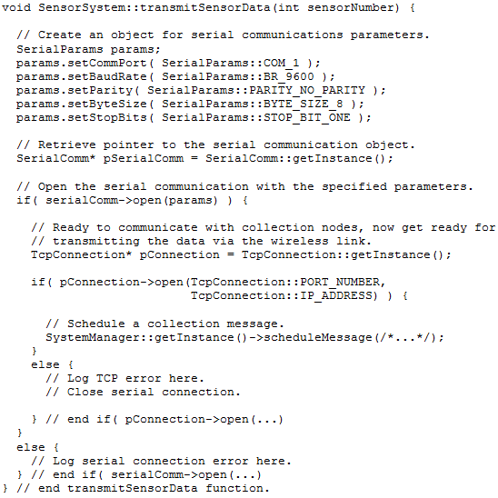
Facade Design Pattern Example
The Façade hides all of these details and dependencies from clients, therefore simplifying the client side.

Slide 29
Facade Design Pattern
The step-by-step procedure for applying the Facade design pattern include:
  Identify all components involved in carrying out a subsystem operation
  Create an ordered list of the operations required to execute the subsystem operation.
  Design a Facade class that includes an interface method to carry out the subsystem operation. The Facade class has dependencies to all other subsystem components required to carry out the subsystem operation.
  Implement the Facade interface method by calling operations on one or more subsystem components, in the order identified in step 2.
  Allow one ore more clients to access the objects of the Facade type so that they can gain access to the subsystem operation. This creates a many-to-one relationship between external subsystems and the Facade interface, instead of many-to-many relationships.
Benefits of the Facade design pattern include:
  Shields clients from knowing the internals of complex subsystem, therefore minimizing complexity in clients.
  Since the internals of the subsystem are prone to change, the facade provides a stable interface that hides changes to internal subsystems; therefore, client code is more stable.
  Promotes weak coupling on clients; with facade, clients depend only on one interface instead of multiple interfaces.

Slide 30
What’s Next…
In this session, we presented structural design patterns, including:
  Adapter
  Composite
  Facade
The next session continues the discussion on patterns by presenting a different category of design patterns capable of encapsulating behavior. These behavioral patterns include:
  Iterator
  Observer

Slide 31
References
[1] Gamma, Erich, Richard Helm, Ralph Johnson, and John Vlissides. Design Patterns: Elements of Reusable Object-Oriented Software. Boston: Addison-Wesley, 1995.

